Slide 1


Introduction to HTML
STIJ3074

Slide 2
3.1 Introduction
Introduction
  HTML = Hyper Text Markup Language
  Markup language
  – used to format text and information.
  hypertext : web pages which contain more than text
    can contain multimedia, provide links for jumping within & beyond
  markup : it works by augmenting text with special symbols (tags) that identify structure and content type

Slide 3
Strengths and Weaknesses
of Markup Language
Strengths | Weaknesses
Easy to develop and quick to learn. Files can be transferred quickly because the code is not compiled. Minimal coding is needed to format large amount of data. | Lack of design and layout capabilities. Files can be interpreted differently by different client program. The code is not compiled, thus difficult to enforce strict coding structure.

Slide 4
3.1 Introduction
HTML Documents
  HTML documents are in source-code form
  It can be created or edited by using
    Text editors (e.g. Notepad, NotePad++, Wordpad, etc.)
    WYSIWYG editors (MS Frontpage, Dreamweaver, MS Word, Visual Studio, etc.)
  .html or .htm file-name extension
  Web server: Stores HTML documents
  Web browser: Requests HTML documents

Slide 5
3.1 Introduction
HTML Tags
HTML is comprised of tags and elements.
Tags are used to mark up the start and end of HTML element.
Tags are enclosed in < >
    e.g.: <html> defines the root of HTML document.
  Most tags come in pairs, marking a beginning and ending
    E.g.: <title> and </title> enclose the title of a page
  HTML tags are not case-sensitive
    Lower-case tags recommended
  HTML tags may contain attributes
  e.g.: <img src=“logo.jpg” />

Slide 6
3.1 Introduction
HTML Tags
HTML consists of two main sections:
  <head> and <body>
Elements (tags) are nested one inside another:
<html>
  <head></head>
  <body></body>
<html>
The HTML source code should be formatted to increase readability and facilitate debugging.
  Every block element should start on a new line.
  Every nested (block) element should be indented.
  Browsers ignore multiple whitespaces in the page source, so formatting is harmless.

Slide 7
HTML Elements
An HTML element is an object enclosed by a pair of tags
    <title>My Home Page</title> is a TITLE element
    <b>This text appears bold.</b> is a BOLD element
    <p>Part of this text is <b>bold</b>.</p>
      is a PARAGRAPH element that contains a BOLD element
Markup Languages

Slide 8
3.1 Introduction
HEAD Section
Holds special information that is not meant to be viewed as part of the page.
Holds TITLE tag, <title> … </title>
  Title of your HTML document which will appear at the top of the browser’s title bar, and also appears in the history list.

Slide 9
3.1 Introduction
BODY Section
Holds page content such as text, images, links, forms, etc.
Holds BODY tag, <body> … </body>.
  This tag is placed before and after, respectively, all the text that will actually appear as the web page.
Elements include background, link colors and font faces.

Slide 10
The <!DOCTYPE> Declaration
HTML documents must start with a document type definition (DTD)
  Must be put in the first line of HTML document, before <html> tag
  It tells web browsers what version of HTML to expect.
  Possible versions: HTML 4.01, HTML 5
Example:
HTML 4.01
<!DOCTYPE HTML PUBLIC "-//W3C//DTD HTML 4.01//EN"
"http://www.w3.org/TR/html4/strict.dtd">
<!DOCTYPE html>
HTML 5
Notes:
*
07/16/96
(c) 2007 National Academy for Software Development - http://academy.devbg.org. All rights reserved. Unauthorized copying or re-distribution is strictly prohibited.*
<number>##

Slide 11
MyFirst HTML Page
Opening tag
<!DOCTYPE HTML>
<html>
<head>
<title>My First HTML Page</title>
</head>
<body>
<h1> HELLO WORLD </h1>
<p> Today is 23 February 2020!</p>
</body>
</html>
Closing tag
Notes:
*
07/16/96
(c) 2007 National Academy for Software Development - http://academy.devbg.org. All rights reserved. Unauthorized copying or re-distribution is strictly prohibited.*
<number>##

Slide 12
Simple Tags
Hyperlink Tags
<a href="http://www.uum.edu.my/"
title="UUM website">Link to UUM Website</a>
Image Tags
<img src="UUMlogo.gif" />
Text formatting Tags
This text is <em>emphasized.</em>
<br >new line<br >
This one is <strong>more emphasized.</strong>
Notes:
*
07/16/96
(c) 2007 National Academy for Software Development - http://academy.devbg.org. All rights reserved. Unauthorized copying or re-distribution is strictly prohibited.*
<number>##

Slide 13
Simple Tags – Example
<!DOCTYPE HTML>
<html>
<head>
<title>Simple Tags Demo</title>
</head>
<body>
<a href="http://www.uum.edu.my"> Link to UUM website</a>
<br>
<img src="logo.gif" alt="logo" />
<br>
<strong>Bold</strong> and <em>italic</em> text.
</body>
</html>

Slide 14
Headings and Paragraphs
Heading Tags (h1 – h6)
Paragraph Tags
Sections: div and span
<h1>Heading 1</h1>
<h2>Sub heading 2</h2>
<h3>Sub heading 3</h3>
<p>This is my first paragraph</p>
<p>This is my second paragraph</p>
<div style="background: skyblue;">
This is a div</div>
Notes:
*
07/16/96
(c) 2007 National Academy for Software Development - http://academy.devbg.org. All rights reserved. Unauthorized copying or re-distribution is strictly prohibited.*
<number>##

Slide 15
Headings and Paragraphs – Example
Headings and paragraphs – Example
<!DOCTYPE HTML>
<html>
<head><title>Headings and paragraphs</title></head>
<body>
<h1>Heading 1</h1>
<h2>Sub heading 2</h2>
<h3>Sub heading 3</h3>
<p>This is my first paragraph</p>
<p>This is my second paragraph</p>
<div style="background:skyblue">This is a div</div>
</body>
</html>

Slide 16
Comments: <!-- --> Tag
Comments can exist anywhere between the <html></html> tags
Comments start with <!-- and end with -->
<!–- UUM Logo (a JPG file) -->
<img src=“UUMlogo.jpg">
<!–- Hyperlink to the web site -->
<a href="http://nst.com.my/">New Straits Times</a>
Notes:
*
07/16/96
(c) 2007 National Academy for Software Development - http://academy.devbg.org. All rights reserved. Unauthorized copying or re-distribution is strictly prohibited.*
<number>##

Slide 17
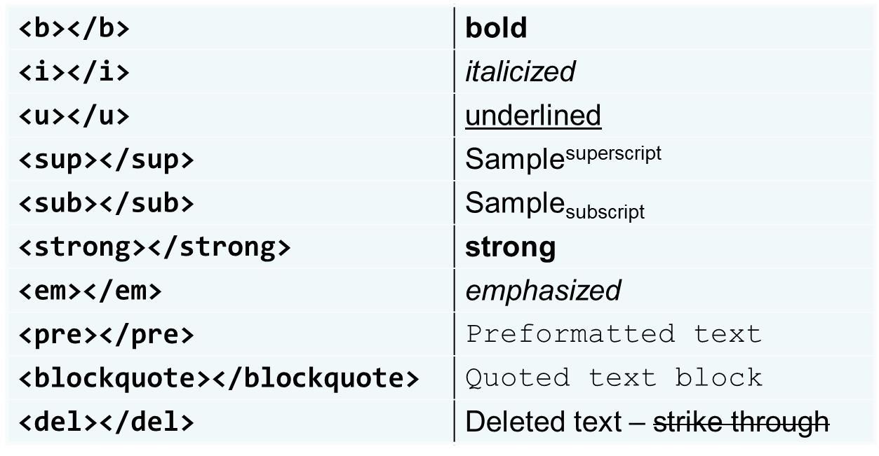
Text Formatting
Text formatting tags modify the text between the opening tag and the closing tag
  Ex. <b>Hello</b> makes “Hello” bold
Notes:
*
07/16/96
(c) 2007 National Academy for Software Development - http://academy.devbg.org. All rights reserved. Unauthorized copying or re-distribution is strictly prohibited.*
<number>##

Slide 18
Exercise1- Hyperlink
Write a code to:
Link to an external Web site
Link to e-mail address
Link to a document called mygallery.html on the same server in the same directory
Link to a document called myFlower.html on the same server in the subdirectory myFav.
Link to a another location in the same document.

Slide 19
Images: <img> tag
Inserting an image with <img> tag:
Image attributes:
Example:
<img src="/img/basd-logo.png">
src | Location of image file (relative or absolute)
alt | Substitute text for display (e.g. in text mode)
height | Number of pixels of the height
width | Number of pixels of the width
border | Size of border, 0 for no border
<img src="./php.jpg" alt= "PHP Logo" />
Notes:
*
07/16/96
(c) 2007 National Academy for Software Development - http://academy.devbg.org. All rights reserved. Unauthorized copying or re-distribution is strictly prohibited.*
<number>##

Slide 20
Ordered Lists: <ol> Tag
Create an Ordered List using <ol></ol>:
Attribute values for type are 1, A, a, I, or i
<ol type="1">
<li>Apple</li>
<li>Orange</li>
<li>Grapefruit</li>
</ol>
Apple
Orange
Grapefruit
Apple
Orange
Grapefruit
Apple
Orange
Grapefruit
Apple
Orange
Grapefruit
Apple
Orange
Grapefruit
Notes:
*
07/16/96
(c) 2007 National Academy for Software Development - http://academy.devbg.org. All rights reserved. Unauthorized copying or re-distribution is strictly prohibited.*
<number>##

Slide 21
Unordered Lists: <ul> Tag
Create an Unordered List using <ul></ul>:
Attribute values for type are:
  disc, circle or square
<ul type="disk">
<li>Apple</li>
<li>Orange</li>
<li>Grapefruit</li>
</ul>
Apple
Orange
Pear
Apple
Orange
Pear
Apple
Orange
Pear
Notes:
*
07/16/96
(c) 2007 National Academy for Software Development - http://academy.devbg.org. All rights reserved. Unauthorized copying or re-distribution is strictly prohibited.*
<number>##

Slide 22
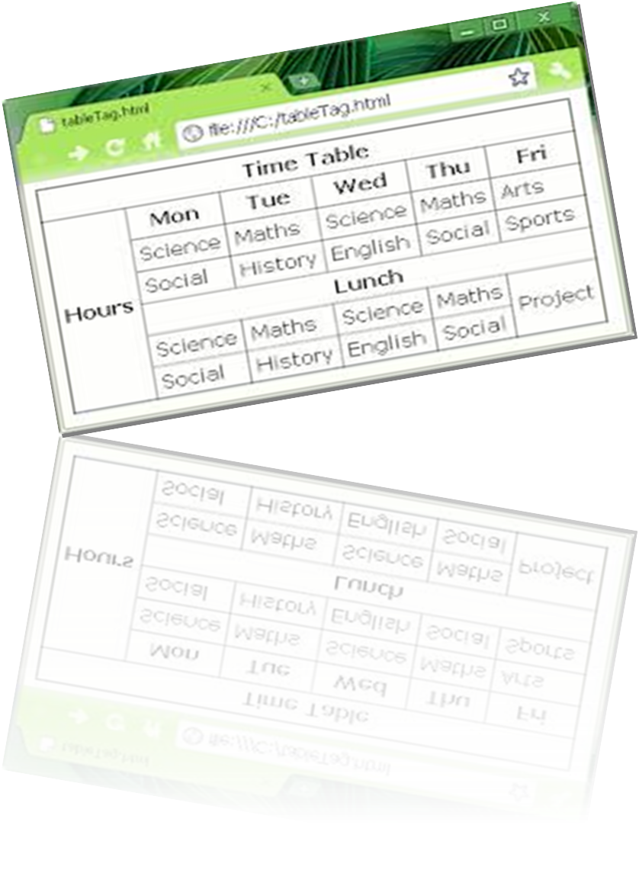
HTML Tables

Slide 23
HTML Tables
Tables represent tabular data
  A table consists of one or several rows
  Each row has one or more columns
Tables comprised of several core tags: <table></table>: begin / end the table
<tr></tr>: create a table row
<td></td>: create tabular data (cell)
Notes:
*
07/16/96
(c) 2007 National Academy for Software Development - http://academy.devbg.org. All rights reserved. Unauthorized copying or re-distribution is strictly prohibited.*
<number>##

Slide 24
HTML Tables
Start and end of a table
Start and end of a row
Start and end of a cell in a row
<table> ... </table>
<tr> ... </tr>
<td> ... </td>

Slide 25
HTML Tables – Example
<table cellspacing="0" cellpadding="5">
<tr>
<td>Logo</td>
<td>Website of favourite transport</td>
</tr>
<tr>
<td><img src=“AirAsia.gif"></td>
<td><a href=“http://www.airasia.com”>
Air Asia Website</a></td>
</tr>
<tr>
<td><img src=“ETS.gif"></td>
<td><a href=“http://www.ktmb.com.my">
KTMB Website</a></td>
</tr>
</table>

Slide 26
Complete HTML Tables
Table rows split into three semantic sections: header, body and footer
  <thead> denotes table header and contains <th> elements, instead of <td> elements
  <tbody> denotes collection of table rows that contain the very data
  <tfoot> denotes table footer but comes BEFORE the <tbody> tag
  <colgroup> and <col> define columns (most often used to set column widths)

Slide 27
Complete HTML Table: Example
<table>
<colgroup>
<col style="width:100px" /><col />
</colgroup>
<thead>
<tr><th>Column 1</th><th>Column 2</th></tr>
</thead>
<tfoot>
<tr><td>Footer 1</td><td>Footer 2</td></tr>
</tfoot>
<tbody>
<tr><td>Cell 1.1</td><td>Cell 1.2</td></tr>
<tr><td>Cell 2.1</td><td>Cell 2.2</td></tr>
</tbody>
</table>
columns
header
th
footer
Last comes the body (data)

Slide 28
Exercise 2
1) Define the following attributes;
  Cellspacing?
  Cellspadding?
  Colspan?
  Rowspan?
Write an HTML document which includes the above attributes.

Slide 29

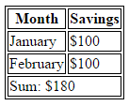
Exercise 2 – Sample of output
Cell[1,1]
Cell[2,1]
Cell[1,2]
Cell[2,2]
Cell[3,2]
Cell[1,3]
Cell[2,3]

Slide 30
Cell Spacing and Padding
Tables have two important attributes:
cellspacing
Defines the empty space between cells
cellpadding
Defines the empty space around the cell content
cell
cell
cell
cell
cell
cell
cell
cell
Notes:
*
07/16/96
(c) 2007 National Academy for Software Development - http://academy.devbg.org. All rights reserved. Unauthorized copying or re-distribution is strictly prohibited.*
<number>##

Slide 31
Cell Spacing and Padding – Example
<html>
<head><title>Table Cells</title></head>
<body>
<table cellspacing="15" cellpadding="0">
<tr><td>First</td>
<td>Second</td></tr>
</table>
<br/>
<table cellspacing="0" cellpadding="10">
<tr><td>First</td><td>Second</td></tr>
</table>
</body>
</html>
Notes:
*
07/16/96
(c) 2007 National Academy for Software Development - http://academy.devbg.org. All rights reserved. Unauthorized copying or re-distribution is strictly prohibited.*
<number>##

Slide 32
Column and Row Span
Table cells have two important attributes:
colspan
Defines how many columns the cell occupies
rowspan
Defines how many rows the cell occupies
colspan="1"
colspan="1"
rowspan="2"
rowspan="1"
cell[1,1]
cell[1,2]
cell[1,1]
cell[1,2]
cell[2,1]
cell[2,1]
colspan="2"
rowspan="1"
Notes:
*
07/16/96
(c) 2007 National Academy for Software Development - http://academy.devbg.org. All rights reserved. Unauthorized copying or re-distribution is strictly prohibited.*
<number>##

Slide 33
Column and Row Span – Example
<table cellspacing="0">
<tr class="1"><td>Cell[1,1]</td>
<td colspan="2">Cell[2,1]</td></tr>
<tr class=“2"><td>Cell[1,2]</td>
<td rowspan="2">Cell[2,2]</td>
<td>Cell[3,2]</td></tr>
<tr class=“3"><td>Cell[1,3]</td>
<td>Cell[2,3]</td></tr>
</table>
Notes:
*
07/16/96
(c) 2007 National Academy for Software Development - http://academy.devbg.org. All rights reserved. Unauthorized copying or re-distribution is strictly prohibited.*
<number>##

Slide 34
Exercise 3
Use an image as hyperlink.
  Clicking the image takes the user to a corresponding web page.

